Slide 1
Small is Big and Slow is Fast – Stockholm University Press as a Case Study on Library Publishing
Christina Lenz, Managing Editor of books
IFLA Special Interest Group (SIG) on Library Publishing 2019 Midterm Meeting
Thursday February 28th – Friday March 1st 2019, Dublin Business School, Dublin, Ireland

Slide 3
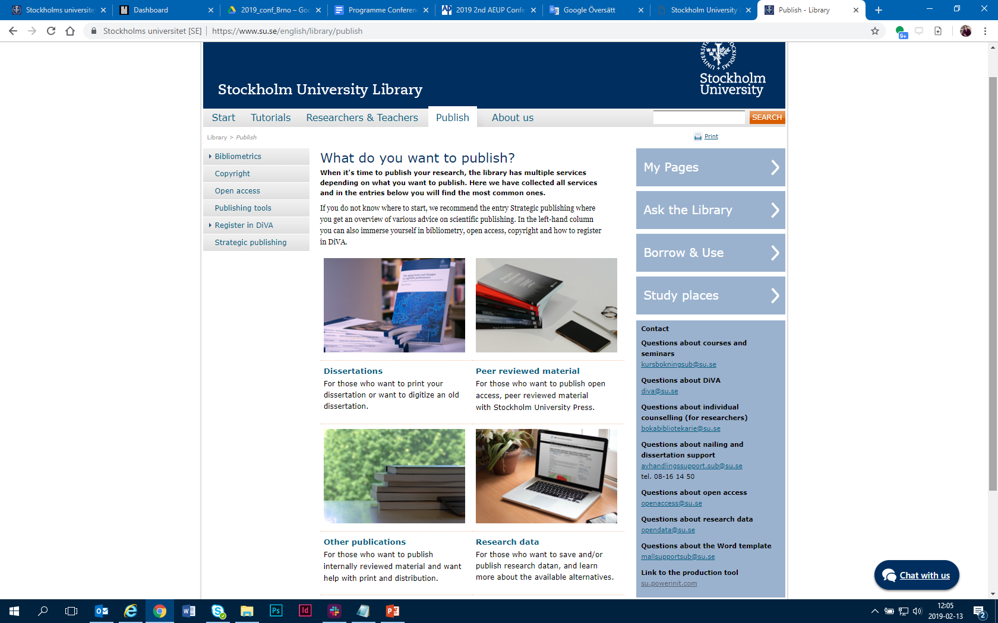
Notes:
Stockholm University Library’s Publishing support
Dissertations – print + pdf + repository
Stockholm University Press (SUP) – External review, OA, DOI, CC BY, 4 ISBNs, ISSN, print on demand
Any book or Acta Universitatis Stolkholmiensis (internal review) – printed edition or POD + pdf in repository
Figshare repository – DOI, pdf, data-formats

Slide 4
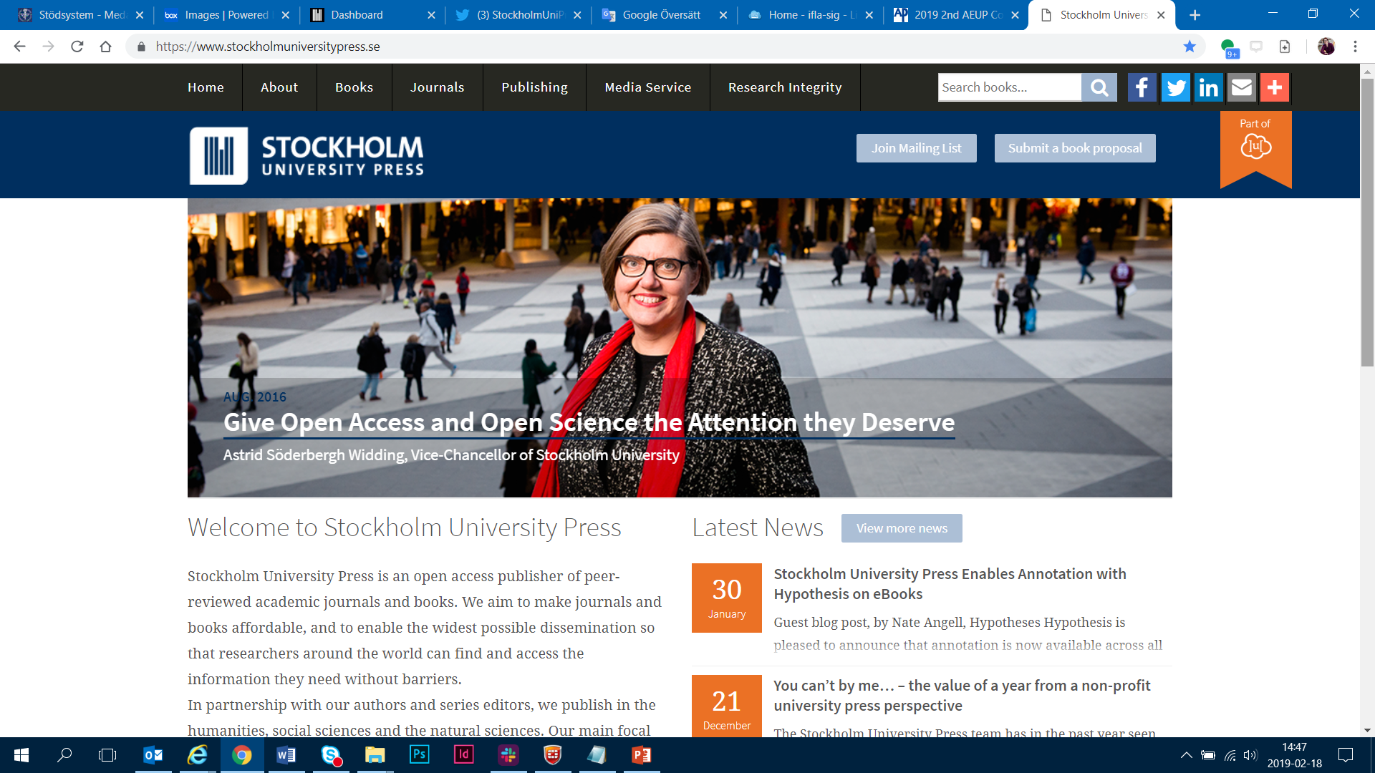

Slide 5
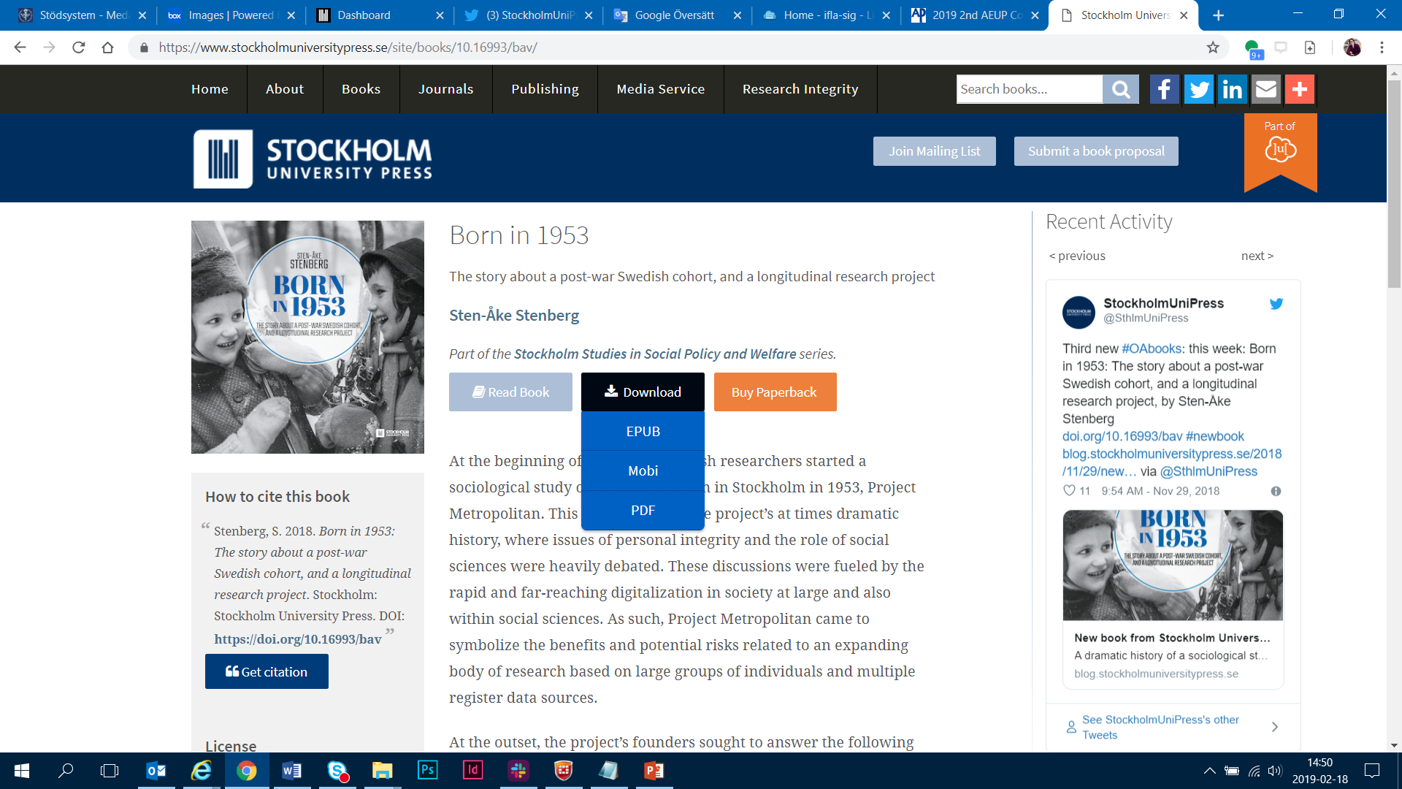

Slide 6
Infrastructure/People for book projects
Editorial Board
SUP/Library
Publishing Committee
Author/Editor
Reviewers
Readers/Users
2019-02-28
Christina Lenz, Stockholm University Library/Press

Slide 7
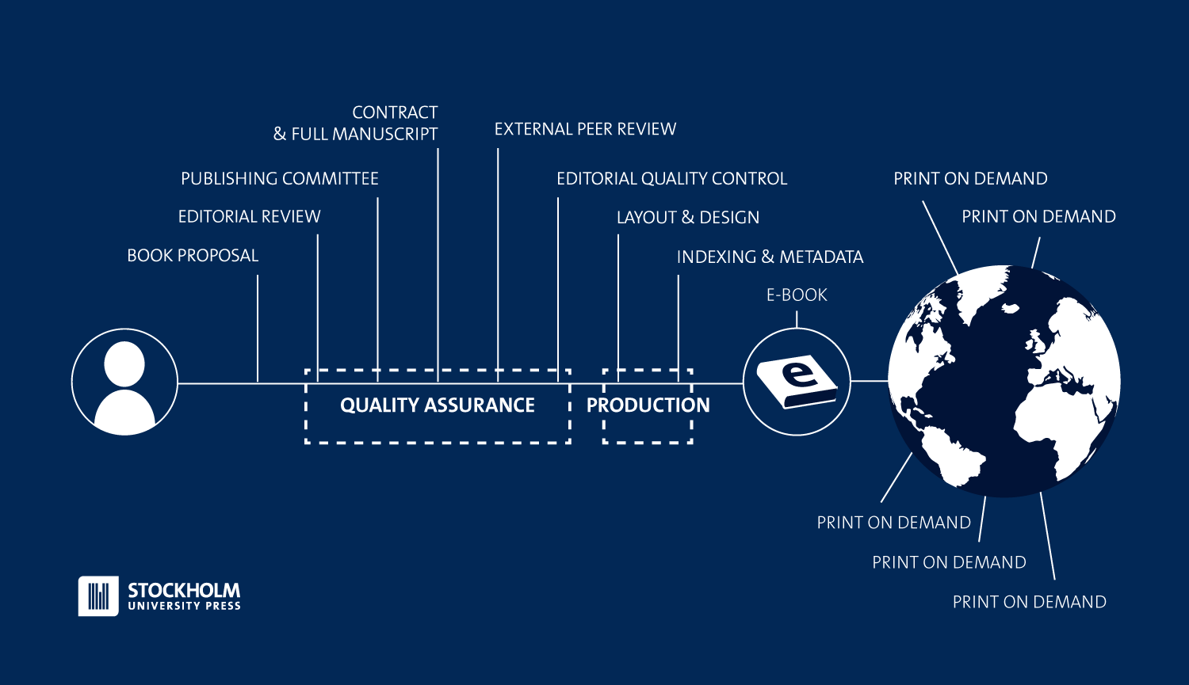
Stockholms universitetsbibliotek

Slide 8
What is ”Quality Assurance”?
Freedom of speech & possibility to submit an appeal
Peer review process – ethical guidelines
Developing good practices & routines for OA scholarly publishing
Anti-plagiarism Checking
Transparent, traceable & understandable
Licensing all material
Archiving
Dissemination in trusted OA channels
2019-02-28
Christina Lenz, Stockholm University Library/Press

Slide 9
Opportunities & challenges
The peer review process
Licensing material
Advocating for OA scholarly publishing
Providing infrastructure services for OA scholarly publishing
Indexing and metadata in relevant channels
Giving back value to the entire university
Collaborations – AEUP, Liber etc.
2019-02-28
Christina Lenz, Stockholm University Library/Press

Slide 10
THANKS!
Christina Lenz, Managing Editor of books
christina.lenz@su.se
@sthlmunipress
@ChristinaLenz_
www.stockholmuniversitypress.se

