Slide 1
Publishing the ITT Short Story Collection Without a Budget!
Niamh Walker-Headon
&
Gerard Connolly

Slide 2
Origins / Background
Red Line Meeting
Internal Proposal
Idea
Funding
‘15
Idea
User Survey Suggestion
Library
Dept Head
TMT
Approval
Library Discussion
Early ‘16
Decision to propose
Co-ordination with Red Line
Split funding – judging and prizes
Launch
Logistics
Online entries only
Library to run, Red Line to include in Book Festival
Open online
Survey Gizmo
Logistics discussed with Red Line
Library Staff Assigned
Outreach to communities:
Local
National
Global
Part of strategic plan
Co-operation with local public library.
Enabled via Red Line Book Festival.
User Survey suggestion
Mid
‘16
SurveyGizmo
Staffing
Reports, allows uploads, no limit on number of responses
Leveraging Staff Strengths
Platform Review
1st Award Ceremony
Took about 6 weeks
10 stories: some read out
Platforms identified and evaluated for function & cost.
Smashwords
CreateSpace
Kindle Direct Publishing
10 short listed stories ready for template
Template loaded and cover created
Mid ‘17
Platform Selection
1st Publication
Ooops – tax clearance
Took much longer because of the tax clearance issues
Notes:
I am going to talk a little bit about the background to the IT Tallaght short story competition run in conjunction with the red line book festival.
It began around 2015 with at a red line book festival advisory committee with the idea of the competition being mooted. Also around this time a user survey had also raised this suggestion. After a discussion at the library it was decided to submit a proposal for funding what became known as ITT shorts.
The proposal was submitted to the head of the humanities department and further progressed to the senior management team and signed off on by the institute president
This happened in early 2016
Two staff members were assigned to this project
It was decided that we would use online services where possible to manage competition.
When the logistics were discussed with red light book festival they volunteered to source and fund the competition judge and we could use the money is provided internally as the prize fund
This left no funding for publication.
It was felt that publication was essential and to gathering interest participation and might increase the numbers entering
The library has used surveygizmo for quite a while and it was decided to use this to gather entries and record consent as it allows for the uploading of a document.
While the competition was launched and gathering entries we created a set of guidelines for short listing which were once used by the staff to create a shortlist for the judge.
Additionally while the competition was running the staff reviewed the platforms available for publication of their functionality including cost and if whether or not copyright had to be surrendered.
Smash words and create space were shortlisted. Creates space fed directly into Kindle Direct Publishing and the Amazon platform, at no cost. We did run into a problem with tax clearance online forms with smash words, which we were unable to complete, so in the end our initial publication happened on create space and KDP.
The first publication took much longer than anticipated because of the issues was getting the tax clearance certificate submitted. This was eventually achieved with the institute finance officer and systems librarian sitting together to complete it online within the create space account set up area.

Slide 3
Platform selection

Slide 4
Timeline 2018
11th June
2nd July
Meeting with SDL & RLBF
New approach
The title Stand Fast!
PR
Opens
Initial entries
SurveyGizmo
Problem-solving
Website, social media, writers’ forums
Closes 13th August
14th September
31st August
Judge contacted
Turn-it-in
Final 10
Shortlisting
in earnest
Judge’s decision
1st October
13th September
2nd October
11th October
Authors & SDL contacted
Liaise with authors & SDL
Award ceremony
Proofing
Editing
Forewords
Anthology uploaded to Amazon – 21st December

Slide 5
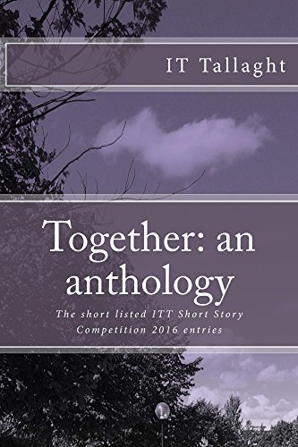
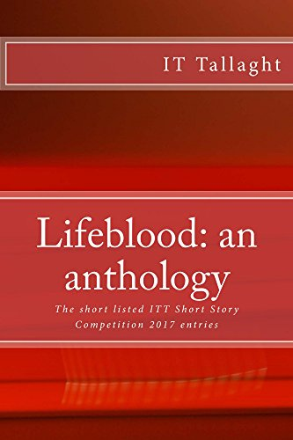
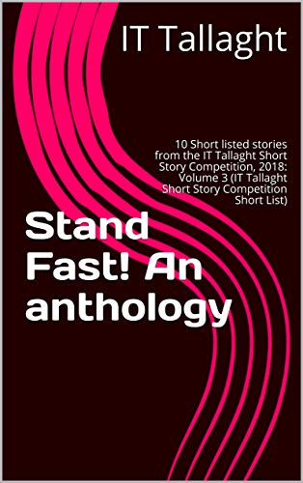
Publication: CreateSpace to KDP 2018
Account > CreateSpace to KDP
Tax Clearance seems to have carried across
Template and Layout seemed to be slightly less problematic with sections and headers
Cover creation > Could not continue with same cover
Proofing and editing, and loading and loading and loading
Print on demand, and e-book
Ordered copies for authors, legal deposit and libraries.
Statistics on sales etc. on account > Pay when it reaches threshold.
(Paypal)
Notes:
As with the number of titles to be printed was always going to be small within the vanity publication in realm really it was decided that this was the best option for the library at the moment as it allows us to create orders for the authors, legal deposit and libraries that need print copies, without having to commit to a large print run.
In order to publish with create space and have it flow into KDP thus enabling display on Amazon we needed to create an account with create space and on KDP.
This year when we went to log into create space it had migrated to KDP publishing only.
That seems to have carried across the tax clearance. The template seemed to be less problematical especially in relation to sections headers and page numbering from KDP.
We were disappointed that we could not continue with the same layout for the cover is the first two years and had to redesign .
We still had to however proofread edit change load, edit change load and so on.
However have this does we now have a series amazon, with the ebook provided by KDP and print on demand for those who want hardcopy.
The KDP allows us to see statistics on sales and so on and you get paid when you meet your particular level of sales or royalties
at the moment this is set up to pay into a paypal account but we have not yet reached this level of sales

Slide 6
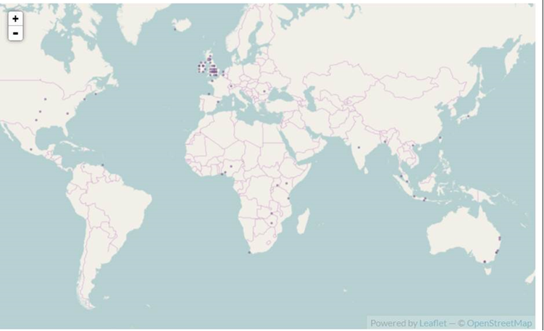
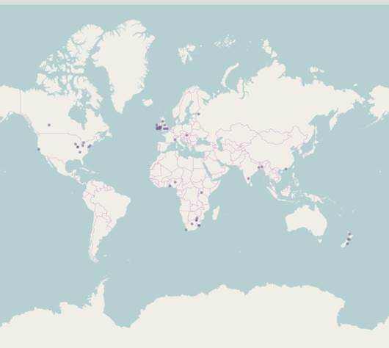
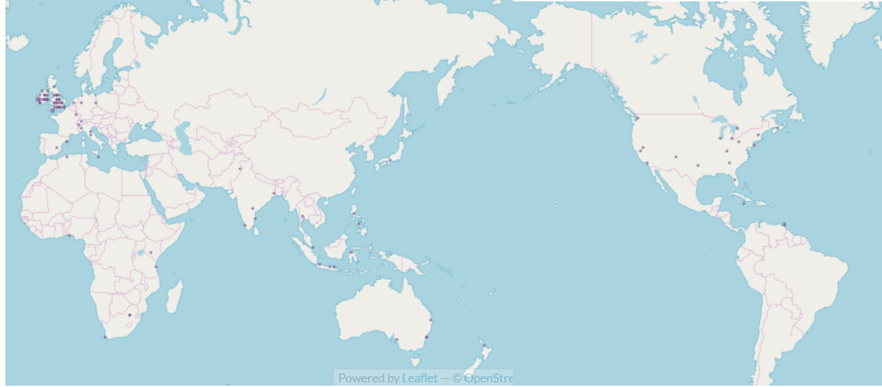
Global response: starting to build a community
2017
2016
2018
Notes:
An interesting part of the competition’s evolution been global spread of the red line book festival and the IT tallaght brand
Communicating with author groups and bloggers via e--mail and social media have spread to word globally. We had 240 entries from 24 countries in 2018.
With the introduction of GDPR it was decided to create a google group for those interested in the competition going forward.
2019 will show whether this works of not.
We are hoping that the community of interest around this competition will continue to grow especially as the publication of the shortlisted stories allows for of their dissemination.

